Slide 1
[openLAB : Interoperate]
Machine Readable V440
For Tekla Structures
Espen Skogsrud, Technical Consultant
espen.skogsrud@buildingpoint-scandinavia.com

Slide 2

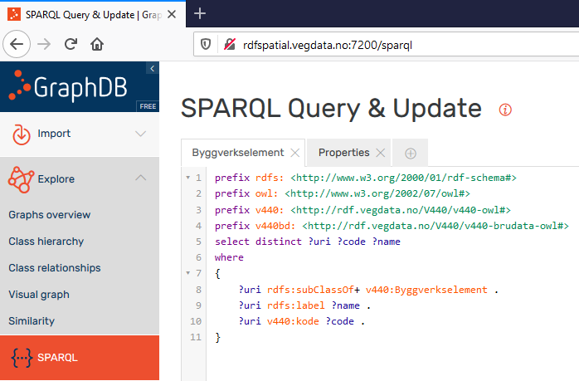
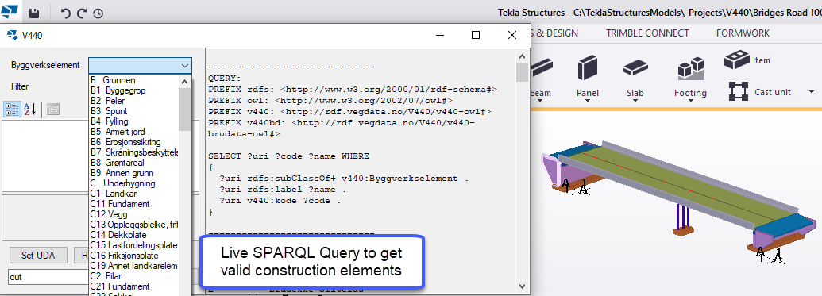
Project Solution – Tekla Structures
Implemented the V440 Handbook using Linked Data/Semantic Web
Utilizing SPARQL endpoint to inqure the onthology
Get ConstructionElement classes and V440 codes

Slide 3
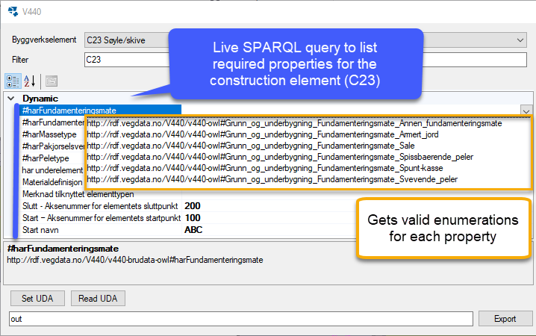
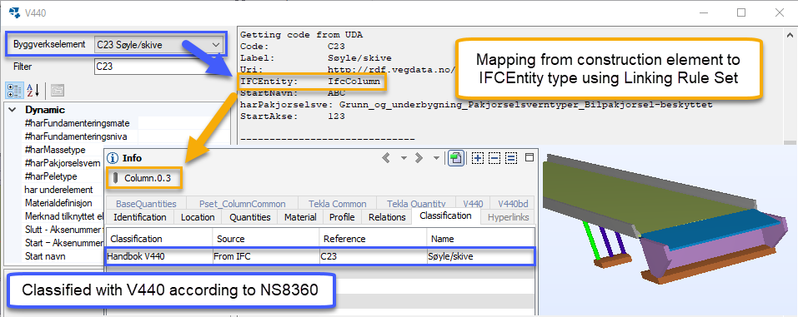
Project Solution – Tekla Structures
Dynamically generate properties for classes
Get enumerable values for properties
Inquire Linking Rule Set for IFCEntity
Export to IFC with classifications and properties

Slide 4


